Slide 1
Impacts on regional life expectancy
2004-2013
Shilpi Ray
Becky Li
Alexis Fox
Bryce Dudka

Slide 2
Title and Content Layout with List
Add your first bullet point here
Add your second bullet point here
Add your third bullet point here

Slide 3
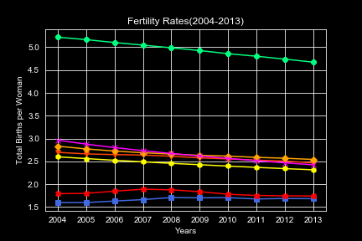
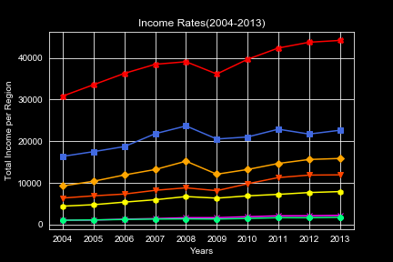
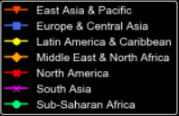
Summary data
Add your first bullet point here
Add your second bullet point here
Add your first bullet point here
Add your second bullet point here

Slide 4
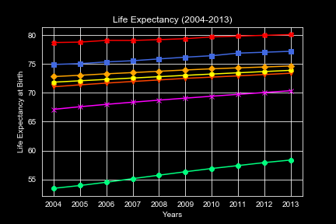
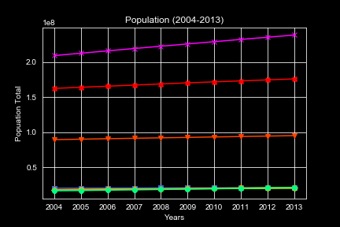
Summary data
Add your first bullet point here
Add your second bullet point here
Add your first bullet point here
Add your second bullet point here

Slide 5
correlations
First bullet point here
Second bullet point here
Third bullet point here

Slide 6
SLIDE TITLE
First bullet point here
Second bullet point here
Third bullet point here
Group A
Task 1
Group B
Task 1
Group C
Task 2
Task 2
Task 1
Task 2

Slide 7
SLIDE TITLE

Slide 8
SLIDE TITLE

Slide 9
Add a Slide Title - 3

Slide 10

SLIDE TITLE

Slide 11
Add a Slide Title - 5

Slide 12
Project summary
First bullet point here
Second bullet point here
Third bullet point here
THANK YOU

